Slide 1
Polarization of Job Opportunities in the US Labor Market
David Autor, MIT

Slide 2
Key Labor Market Challenges
Increased demand for skilled workers > increased supply of skilled workers
Two rose in sync until the late 1970s
Race Against the Machine by Brynjolfsson and McAfee http://raceagainstthemachine.com/
Structure of the job opportunities in the US has become sharply polarized over the past two decades.

Slide 3
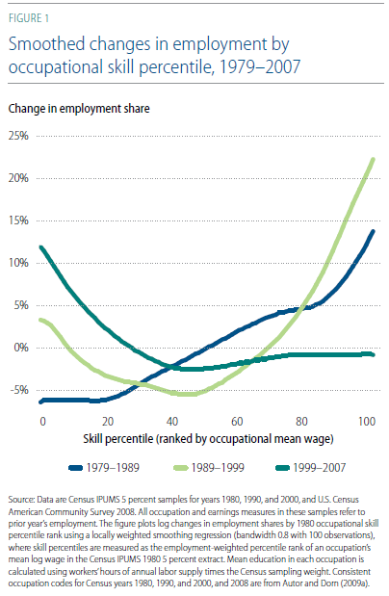
Notes:
Expanded share for high wage (especially in the 1990s). Contracted for middle wage categories – all periods

Slide 4
Key Forces Behind Changes
Slow growth of 4 year college degree attainments – especially for males
Shifts in gender and racial composition of the work force
Changes in technology, trade and off-shoring drive employment distribution changes
Changes in labor market institutions – private sector unions and minimum wage

Slide 5
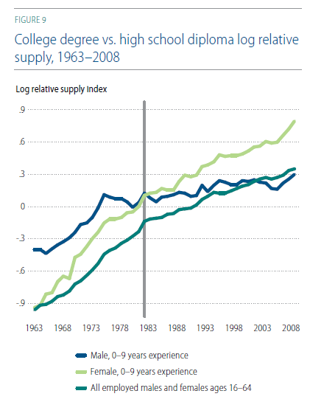

Slide 6
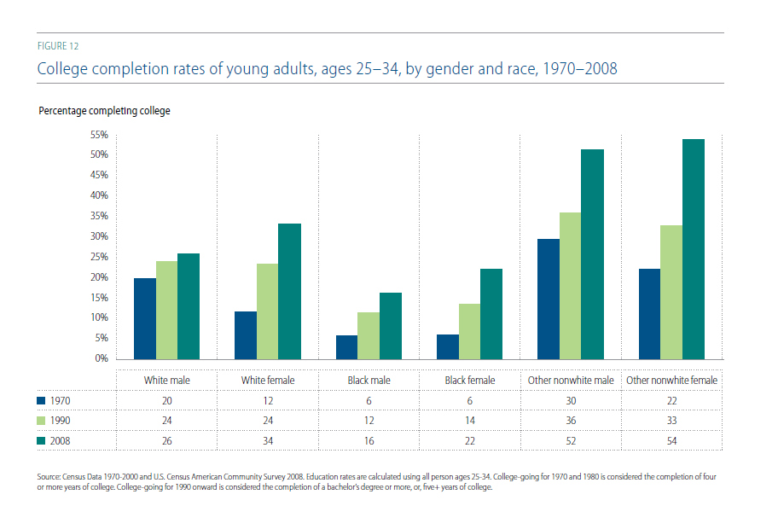

Slide 7
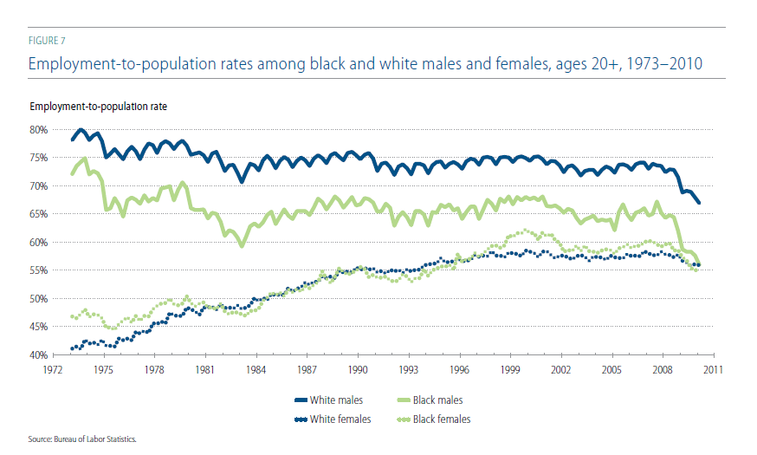

Slide 8
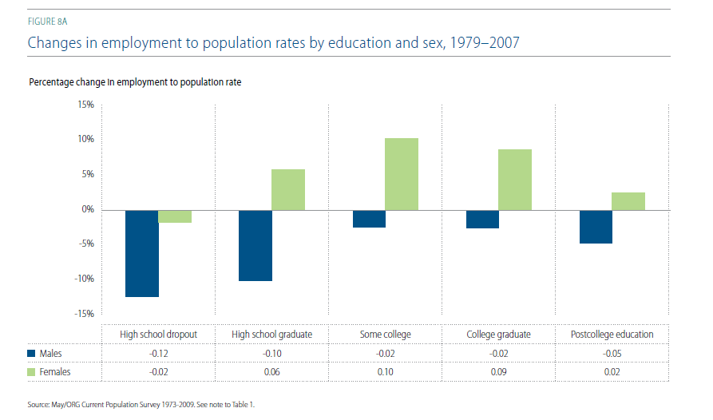

Slide 9
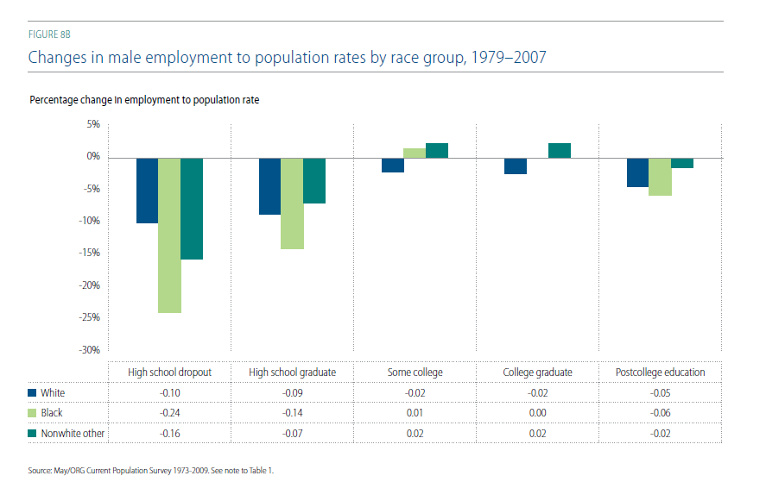

Slide 10
Employment Growth by Occupation

Slide 11
Not just a US phenomenon

Slide 12
Older as well as younger populations

Slide 13
True for most European Countries

Slide 14
Other Conclusions
Automation of routine work and globalization of labor markets are key drivers of polarization.
The Great Recession exacerbated these trends.
College-educated workers earnings have risen relative to high school educated workers over the past three decades.

Slide 15
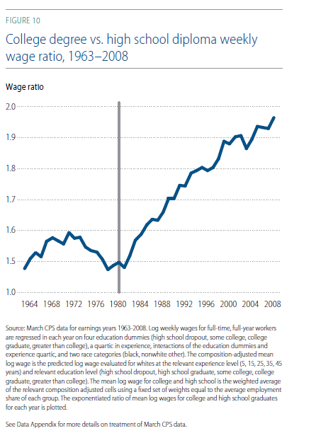

Slide 16
Average Annual Earnings by Education Level - EROP 2012

Slide 17
Projected Employment Growth by Education Level – EROP 2012

